Slide 1
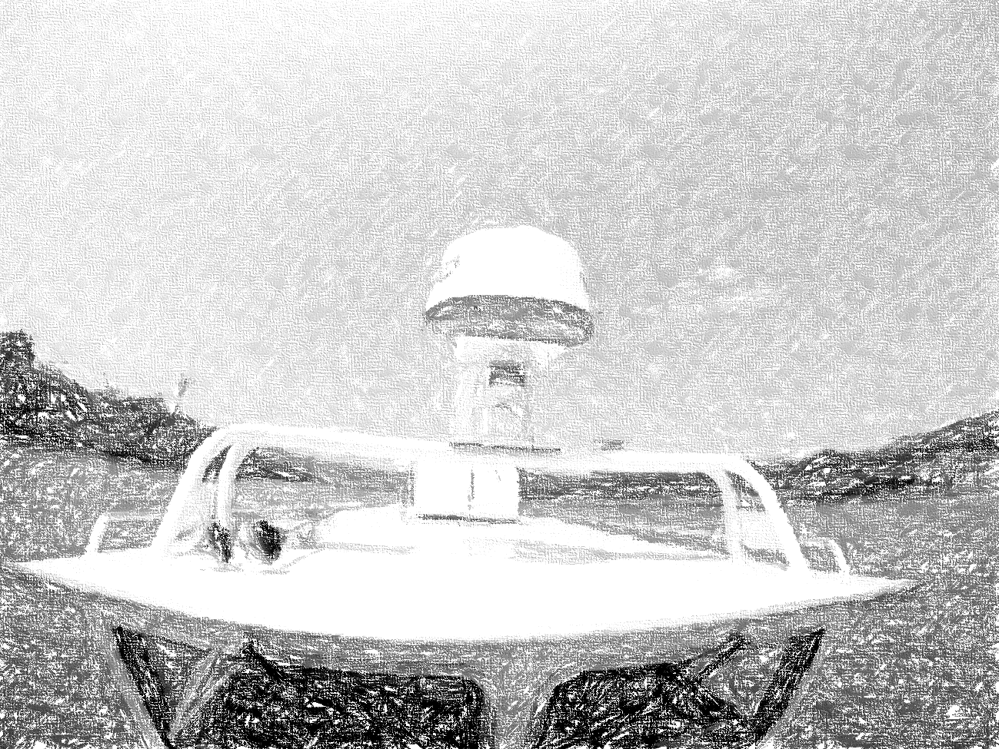


Autonomous Water Taxi
Critical Design Review
By: AutoPirates
Date: 29 Feb 2016
Project Sponsors:
Team B: Tushar, Shiyu, Bikramjot, Tae-Hyung, William

Slide 2
Content
Project description
Use case/System graphical representation
System-level requirements
Current system status
Project management
Conclusions

Slide 3
Project Description

Slide 4
Project Description
Problem
Pittsburgh lacks a viable river transportation system
Many attractions are located along the river
Currently, only luxury cruise lines available
Solution
AutoPirates is an autonomous water taxi service
A pleasant way to commute to work
More efficient than automobiles in reaching riverfront locations

Slide 5
Use Case

Slide 6

Use Case: System Graphical Representation
James would like to spend a nice day with his family, beginning with some shopping at Walmart, followed by an exciting game at PNC Park, and finally a nice dinner at the Cheesecake Factory in Southside Works.

Slide 7


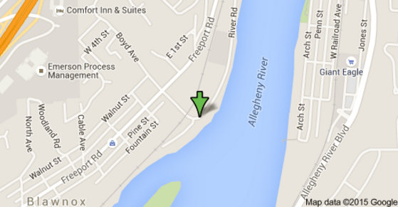
Use Case: System Graphical Representation
Welcome James!
Where you want to go today?
James books the cab from AutoPirates iOS app.
Your Location : Monongahela
Destination : Southside Works
Estimated Fare : $13
Book Now
Powered by AutoPirates
*Phone App not in scope

Slide 8
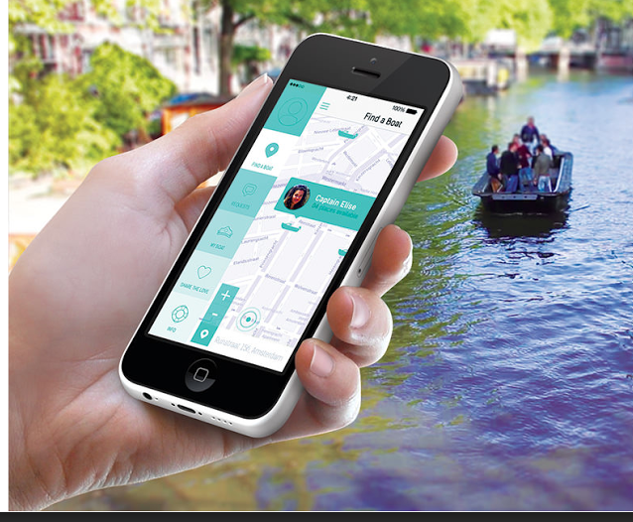
Use Case: System Graphical Representation
Boat arrives to pick James family

Slide 9
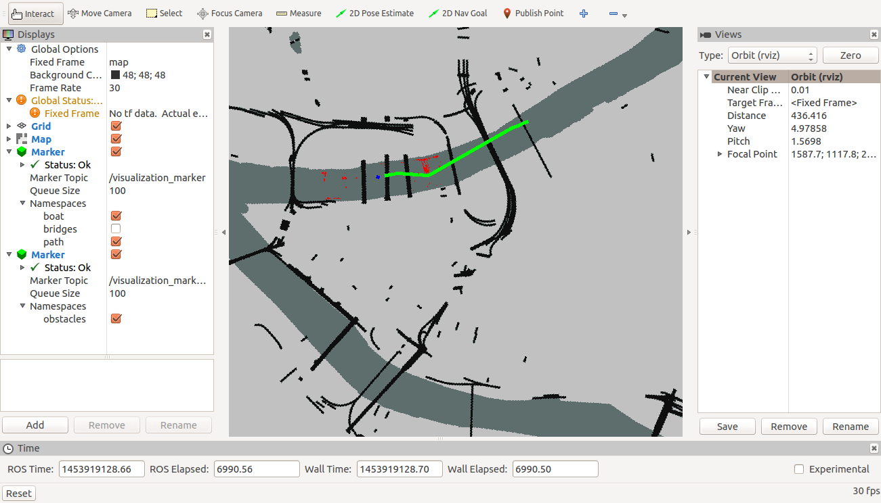
Use Case: Reality check
James confirms the destination on Operator Control Unit (OCU)
OCU also shows the path to his destination

Slide 10
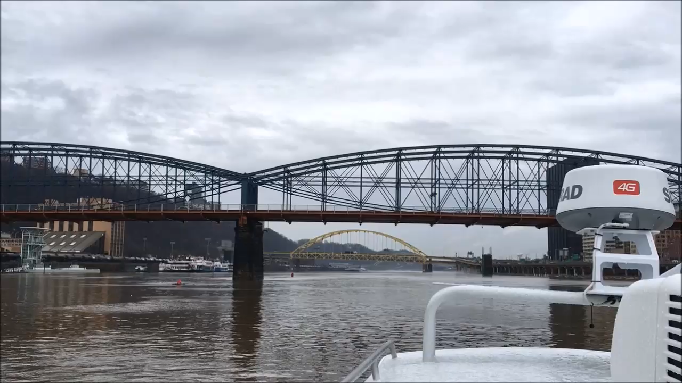
Use Case: System Graphical Representation
Boat avoids obstacles and pylons in between the path.
It also navigates successfully under the bridges.

Slide 11
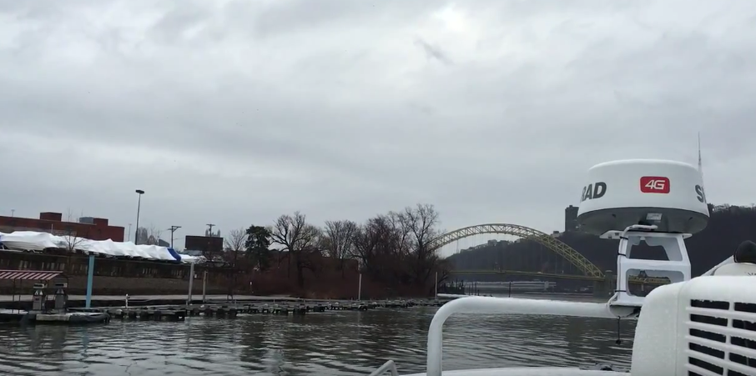
Use Case: System Graphical Representation
The destination arrives

Slide 12
Requirements

Slide 13
System Requirements: Mandatory Functional
The system shall
MF1. Interfacing with low level controller on boat, IMU/GPS and Radar
MF2. Detect static obstacles in the river with minimum size of 2mtx2mtx2mt with more than 85% accuracy.
MF3. Segment shores and bridges
MF4. Autonomously navigate from source to destination at the maximum distance of 2 miles in not more than 15 minutes.
MF5. Avoid detected static obstacles with an accuracy of more than 95%.
MF6. Update the path within 5 sec after detecting new static obstacles.
MF7. Record sensor data up to duration of 15 minutes.
MF8. Replay saved sensor data.
MF9. Have a 2D simulator to test path planning algorithm.
MF.10 Generate Occupancy grid map of environment
Tested during field tests
Partially Tested (Re-planning)
Not Tested

Slide 14
System Requirements
Desirable functional requirements
The system shall -
DF1. Track dynamic obstacles with minimum size of 1m x 1m x 1m.
DF2. Update the path within 2sec after detecting new dynamic obstacles.
Mandatory non-functional requirements
The system shall -
MNF1. Be tested in 25-30 field trials.
MNF2. Arrive within a radius of 15 meters of the desired destination.
MNF3. Be demonstrated in a video.
MNF4. Sail at a velocity not more than 15 mph.
Desirable non-functional requirements
The system shall -
DNF1. Obey the “rules of the road”.
DNF2. Estimate the shape of the static obstacles in the river with a minimum of 50% overlap.
Done/Adhering
Working on it
Out of scope

Slide 15
Current Status

Slide 16
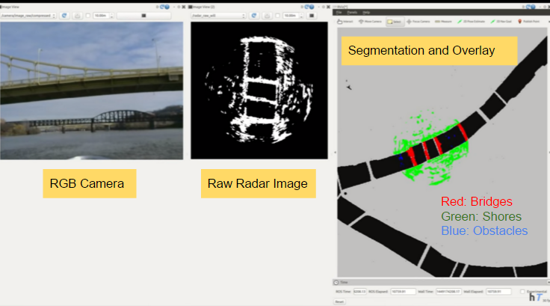
Current Status: Perception | Fall’15

Slide 17
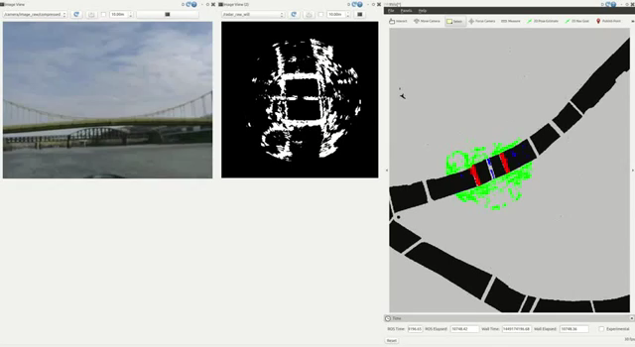
Current Status: Perception | Fall’15 Video

Slide 18
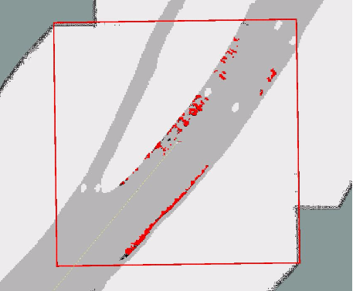
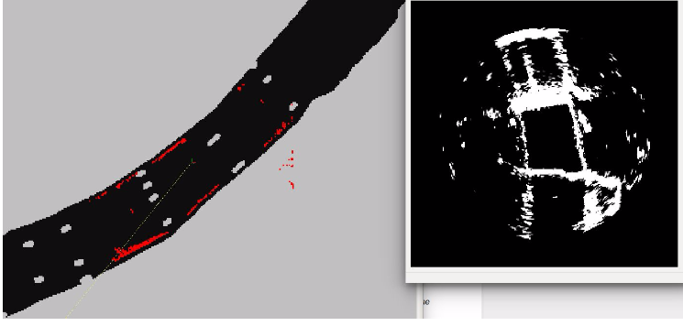
Current Status: Perception | Filtering Improvements in Spring
Octomap: Radar data converted to Octomap
Less noise as compared to binomial filtering

Slide 19
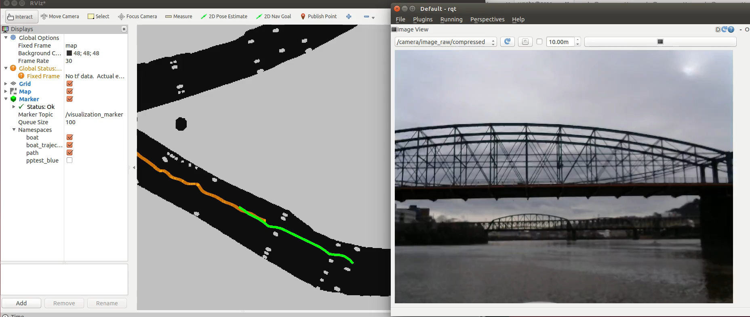
Current Status: Path Planning | Field Test 3 | One Time Planning

Slide 20
Current Status: Path Planning | Field Test 3 | Continuous Re-planning (partially successful)

Slide 21
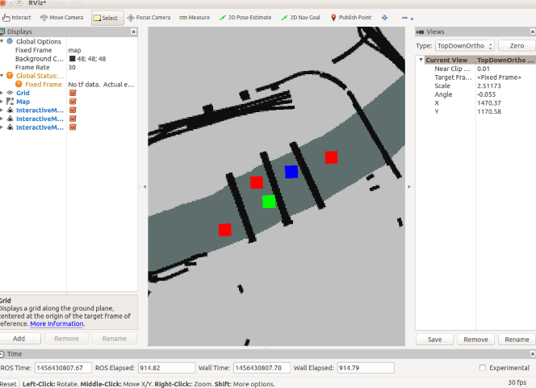
Current Status: Simulator
Fake Obstacles
Static
Random Dynamic
Tele-operated

Slide 22
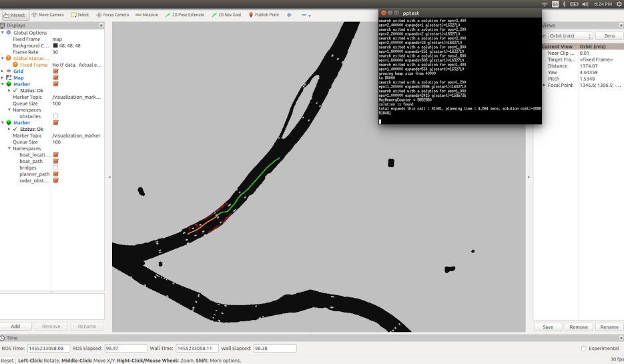
Current Status: Integration (To be tested during Field Test 4)

Slide 23
Project Management

Slide 24
Work Breakdown Structure | Schedule Status
Autonomous Water Taxi
Perception
Path planning
Mapping & Localization
Simulator
Integration
Testing
Project Management
Get raw data from Radar
Interface IMU/GPS
Import external navigation map
Generate a world model
Integrate OpenCPN with ROS
Sensor test
Task scheduling
Position and pose estimation
Algorithms test
Field management
Filter data
Generate occupancy grid map
Apply path planning algorithm to the boat model
Integrate SBPL library with external map
Morphological operation
Interface SBPL library
Field test
Budget management
Localize boat on the map
Integrate perception with path planning
Performance evaluation
Risk management
Contour extraction
Algorithm evaluation
Overlay radar image on the map
Evaluate performance for obstacles avoidance
Obstacle detection
Send command to low-level controller
Optimize radar filters
Dynamically run planner
Subsystem
Finished
In progress
Not started

Slide 25
Spring Validation Experiments: Test Plan
PR No. | Date | Milestones
PR.7 | Jan 27 | Improve costmap functionality and path planning simulation
PR.8 | Feb 10 | Robust single time planning and re-planning (in progress)
PR.9 | Feb 24 | Improve Filtering of Radar data
PR.10 | Mar 16 | Integrate radar obstacles with path planner and re-planning
PR.11 | Mar 30 | Rules of road and dry run to Identify and practice exact scenario for SVE
PR.12 | Apr 11 | Back up to fix bugs or enhace performance
Field Test 3
Field Test 4
Field Test 5
Field Test 6

Slide 26
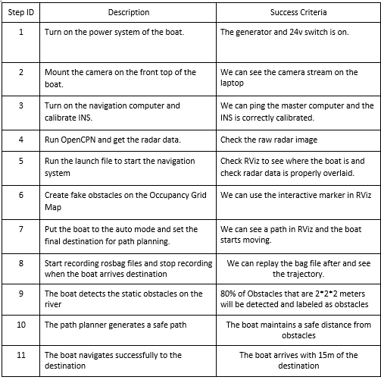
Spring Validation Experiments: Script for final demo

Slide 27
Budget Allocation
Hardware/Equipment/Budget provided by the sponsor (NREC)
S.No | Part | Part Name | Quantity
1 | Boat | 2015 SeaHawk OS 2700S | 1
2 | Radar | SimRad 4G FMCW Radar | 1
3 | Lidar | Velodyne VLP-16 | 1
4 | IMU/GPS | Novatel SPAN with IMU positioning | 1
5 | Laptop | Dell i7 | 5
6 | Proprietary Boards | SBC and Microcontroller boards | 2
7 | Trails for testing | $800 per field test | 25
From RI Budget $4000
S.No | Name | Description | Quantity | Cost | Total | Spent | Left
1 | Transportation | Travel to NREC (5 people) | 64 | 25 | 1600 | 50 | 1550
2 | Videography | Professional video for NREC | 1 | 500 | 500 | 0 | 500
3 | Backup for Trails | Incase we run out of allotted 25 trails | 2 | 800 | 1600 | 0 | 1600
4 | Miscellaneous | To buy camera, contraption, books, etc | 1 | 300 | 300 | 54 | 246
Available
3896

Slide 28
Risk Assessment
Risk ID | Risk Title | Req | Type | Description | Impact Statement | Likeli- hood (1-5) | Conse- quences(1-5) | Mitigating Actions
1 | Test environment availability | All | Testing | Won’t be able to do field testing because of weather conditions | Delay in the progress and insufficient data collect for algorithms | 4 | 3 | Test radar perception on shore for static obstacles. Use a simulator for path planning
2 | Limited testing trials | MNFR2 | Project management | Only 25-30 field tests | Unable to do system integration before demonstration | 5 | 3 | Appoint a field manager to plan logistics of each test.
3 | Radar Performance | MF2, MF3, DF1, DF2 | Technical | Radar signal is too noisy | Inadequate object detection with only radar | 3 | 4 | Incorporate additional sensors like Lidar and camera

Slide 29
Risk Assessment
Risk ID | Risk Title | Req | Type | Description | Impact Statement | Likeli- Hood (1-5) | Conse- Quences (1-5) | Mitigating Actions
4 | Radar cannot detect bridge supports | All | Technical | The Radar only has 2D information | We can’t plan path without knowing the location of the bridge supports | 5 | 5 | Research nautical maps that has information for the bridge supports
5 | Code Efficiency | All | Technical | Code may run too slow after integration | Poor system performance | 5 | 4 | Integration early and often to identify bottlenecks
6 | Team Communication | All | Project management | Language barrier in the team | It may be difficult to express ideas. | 4 | 2 | Do more preparations before the meetings

Slide 30
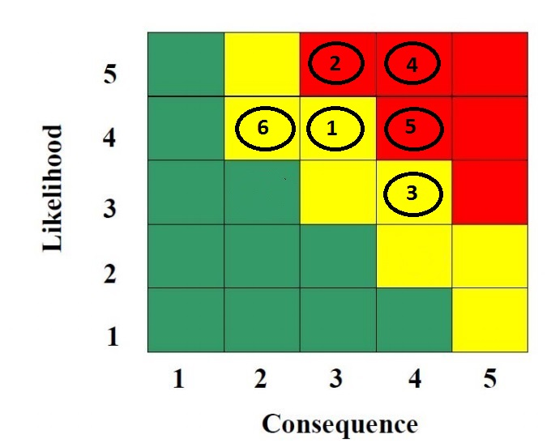
Risk Assessment

Slide 31
Questions

